Slide 1
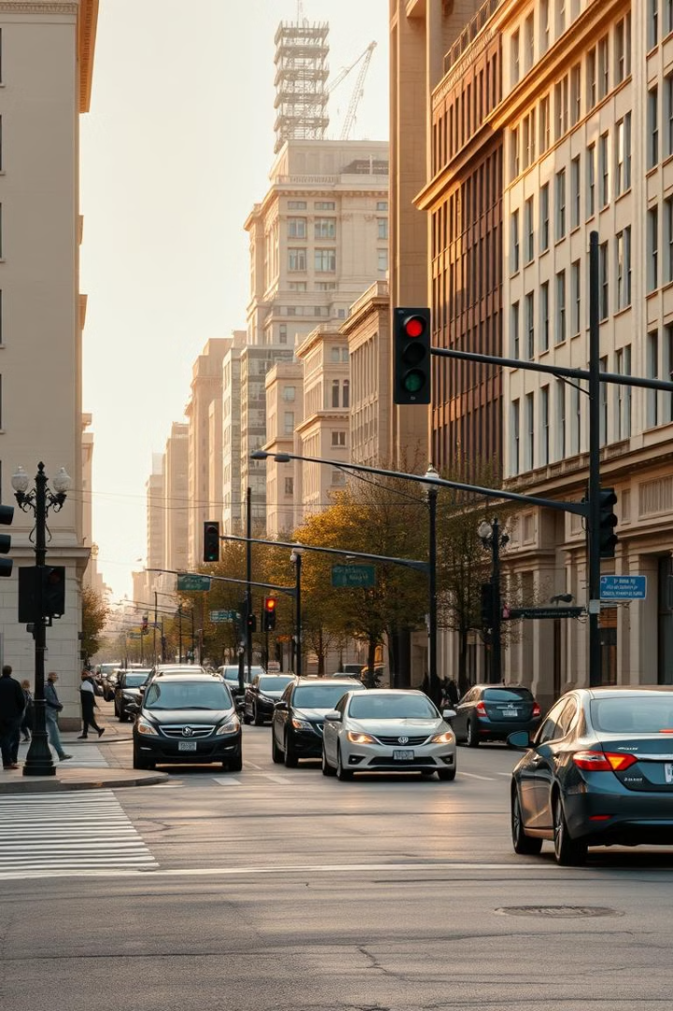
Traffic Signal Automata using FTPG Technology
FTPG (Flexible Time-Phase Grid) technology is revolutionizing traffic management by using real-time data analysis to adapt signal timing and optimize traffic flow through intelligent automation.
K. Ravisankar Guptha(192210038)
B. Venkata tharun(192210090)

Slide 2

Introduction to FTPG (Flexible Time-Phase Grid) Technology
Data Collection
Optimization
FTPG utilizes a network of sensors to continuously monitor traffic conditions in real-time.
FTPG's advanced algorithms continuously optimize the traffic grid to maintain efficient traffic flow.
1
2
3
Adaptive Signaling
The system dynamically adjusts signal timing based on the collected data to minimize congestion and delays.

Slide 3
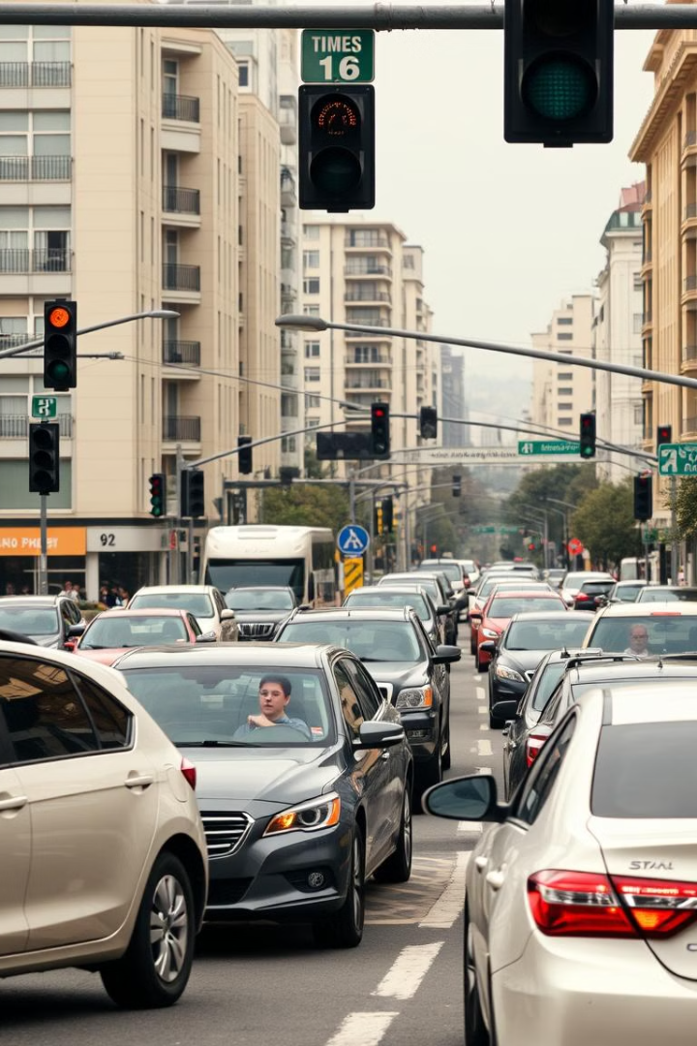
Limitations of Traditional Traffic Signal Systems
1
Inflexible Timing
2
Inefficient Flow
Traditional systems use fixed signal timing that cannot adapt to changing traffic patterns.
Rigid timing leads to unnecessary delays, stop-and-go traffic, and wasted fuel.
3
Lack of Integration
Isolated traffic signals are unable to coordinate with each other for optimal performance.

Slide 4
FTPG: A Smarter Approach to Traffic Management
Adaptive Timing
Coordinated Network
Predictive Analytics
FTPG signals continuously adjust to actual traffic conditions, reducing wait times and improving flow.
The grid-like system enables signals to communicate and synchronize for optimal citywide performance.
FTPG leverages historical and real-time data to anticipate traffic patterns and proactively optimize signaling.

Slide 5
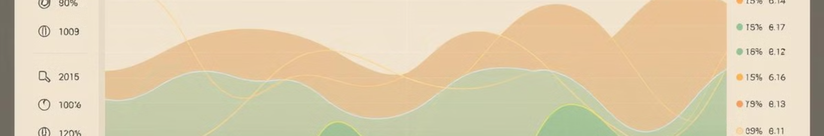
Real-Time Data Analysis and Adaptive Signaling
Sensor Network
Adaptive Control
FTPG systems utilize a dense network of traffic sensors to continuously monitor conditions.
Based on the insights, FTPG signals dynamically adjust their timing to minimize delays and congestion.
1
2
3
Data Processing
Advanced analytics algorithms analyze the sensor data to identify trends and predict traffic flow.

Slide 6
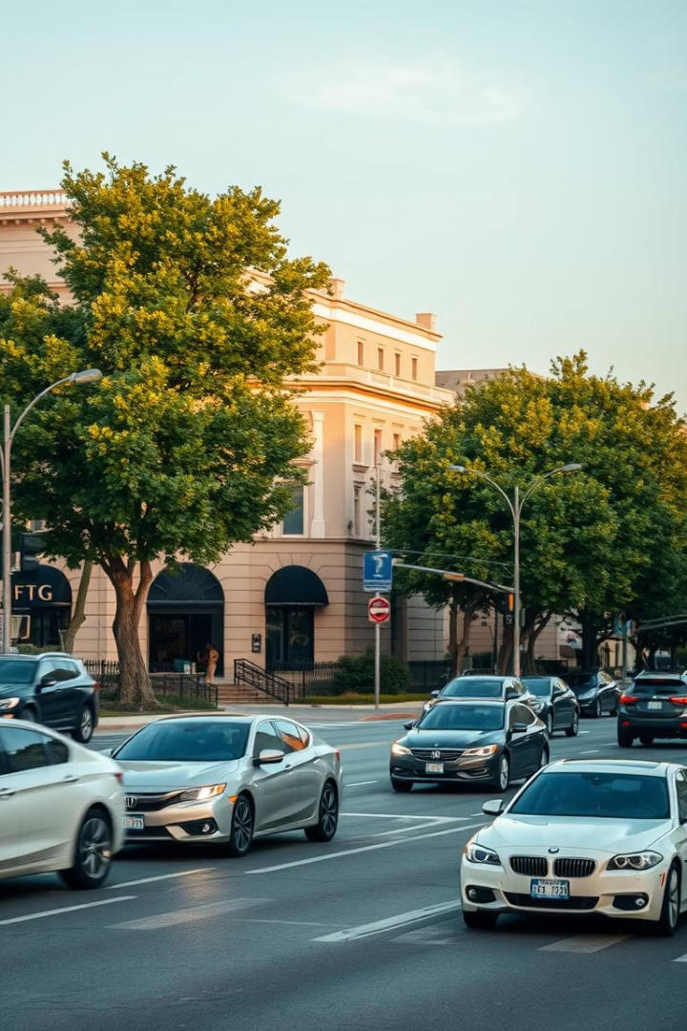



Optimizing Traffic Flow with FTPG
Reduced Congestion
FTPG's adaptive signals keep traffic moving efficiently, minimizing the buildup of vehicles.
Improved Travel Time
Drivers experience shorter and more reliable journey times due to the optimized flow.
Fuel Savings
By reducing stop-and-go traffic, FTPG helps drivers conserve fuel and lower emissions.

Slide 7




Integrating FTPG with Connected Vehicles
Vehicle-to-Infrastructure
Real-Time Coordination
Autonomous Integration
FTPG signals exchange data with connected vehicles to further optimize traffic flow.
The integrated system can predict and respond to vehicle movements in real-time.
FTPG supports the seamless integration of self-driving cars for a more efficient future.

Slide 8
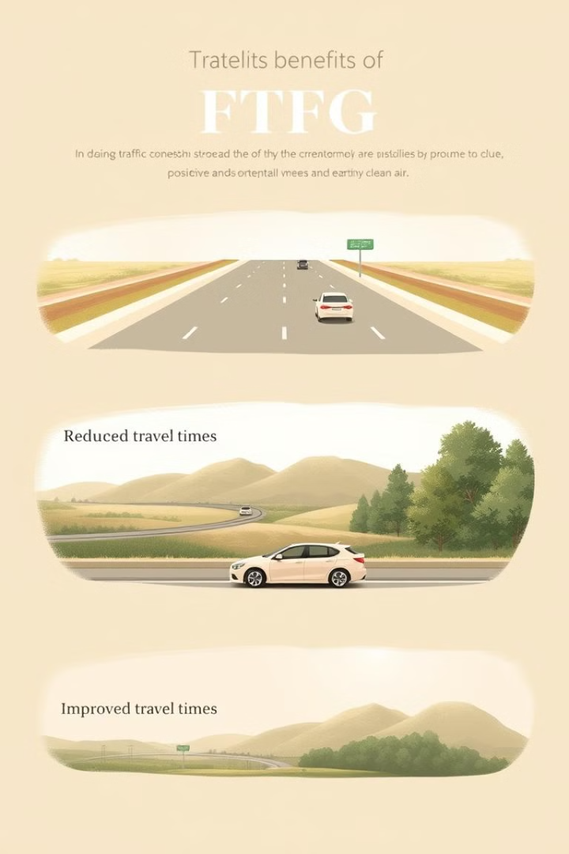
Benefits of Implementing FTPG Technology
Improved Efficiency
Environmental Impact
FTPG's adaptive signaling optimizes traffic flow, reducing delays and congestion.
By minimizing stop-and-go traffic, FTPG helps lower fuel consumption and emissions.
Economic Benefits
Scalable Solution
The technology saves drivers time and money, while also reducing infrastructure costs.
FTPG can be seamlessly integrated into existing traffic management systems.

Slide 9
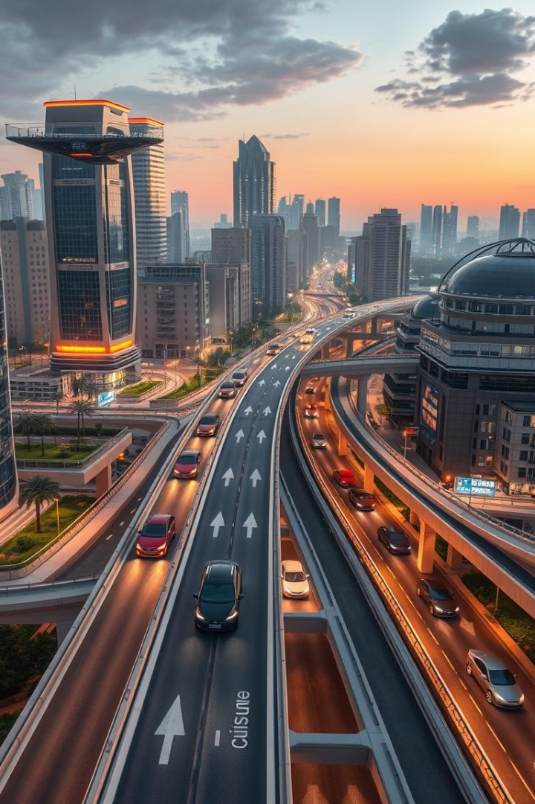
Conclusion and Future Advancements
FTPG technology is revolutionizing traffic management, delivering a smarter, more efficient, and environmentally-friendly approach. As it continues to evolve, FTPG will play a crucial role in shaping the future of urban mobility and transportation.

